Slide 1

Careers in Business Intelligence
SQLSat Baton Rouge BI 2020
Notes:
C
Hi, Welcome to Ethics in Modern Data. My name is Christine Assaf
I’m William Assaf.
Today we’re going to talk about Bias, transparency, and the impact of ethics in modern data.

Slide 2
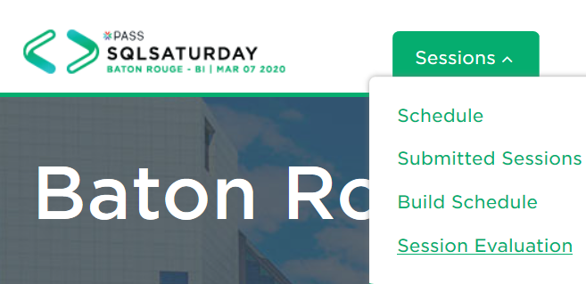
Session Evaluations are ONLINE ONLY
Your feedback is valuable!
https://www.sqlsaturday.com/929/EventHome.aspx

